Slide 1
Hyperspectral Data Classification
Jun Chen, Dan Wang,
Zhou Zhang, Penghao Wang

Slide 2
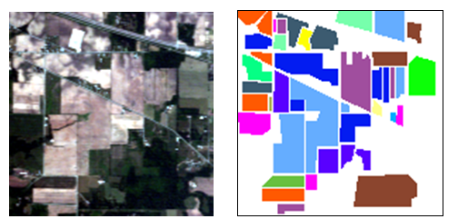
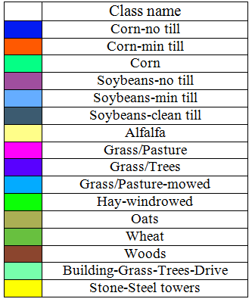
Hyperspectral Image: Indian Pine
RGB Image
Ground Reference
Indian Pine Agriculture, Indiana
AVIRIS airborne, June 1992
220 spectral bands
Spectral resolution 10nm
Spatial resolution 20m
16 classes of crops

Slide 3
Supervised Classifiers
Considering the high dimensionality of the data, we used the following three classifiers:
Kernel SVM
Gaussian kernel, cross-validation for parameter selection
Random Forest
(some description, how to tuned parameter?)
Adaboost
(which classifier? Decision tree or decision stump? How to tuned the parameter?)

Slide 4
Data Preprocessing
Remove noisy spectral bands (features), and use 200 out of 220 as final features.
Ignore minor classes with very labeled samples, and focus on 12 out of 16 classes.
For each class, randomly select 100 labeled samples for training and 100 for testing.
Normalize the data for each feature.

Slide 5
Results Evaluation
 | Kernel SVM | Decision Tree | Adaboost
Overall Accuracy | 0.85
Corn-no till (C1) | 0.72
Corn-min till (C2) | 0.67
Corn (C3) | 0.91
Soybeans-no till (C4) | 0.82
Soybeans-min till (C5) | 0.77
Soybeans-clean till (C6) | 0.78
Grass/Pasture (C7) | 0.95
Grass/Trees (C8) | 0.94
Hay-windrowed (C9) | 0.99
Wheat (C10) | 0.99
Woods (C11) | 0.83
Building-Grass-Trees-Drive (C12) | 0.78

Slide 6
Results Evaluation(training)
 | Kernel SVM | Random Forest | Adaboost
Overall Accuracy | 0.998 | 1
Corn-no till (C1) | 1.000 | 1
Corn-min till (C2) | 1.000 | 1
Corn (C3) | 1.000 | 1
Soybeans-no till (C4) | 1.000 | 1
Soybeans-min till (C5) | 0.990 | 1
Soybeans-clean till (C6) | 1.000 | 1
Grass/Pasture (C7) | 1.000 | 1
Grass/Trees (C8) | 1.000 | 1
Hay-windrowed (C9) | 1.000 | 1
Wheat (C10) | 1.000 | 1
Woods (C11) | 1.000 | 1
Building-Grass-Trees-Drive (C12) | 0.99 | 1

